Slide 1

Analysis and control of linear systems
Sergey Lovlin , Galina Demidova, Aleksandr Mamatov
Faculty of Control Systems and Industrial Robotics , ITMO University , Saint Petersburg

Slide 2
Content
Automatic control systems
Quality criteria of control systems
Accuracy indicators of control systems
Typical Regulators
Ziegler-Nichols method

Slide 3
Automatic control systems
Faculty of Control Systems and Industrial Robotics , ITMO University , Saint Petersburg

Slide 4
Introduction
Automatic control systems:
give new properties to technological equipment;
allow you to increase the speed of operating modes ;
saving consumables and electricity;
improving the quality of products due to the precision measuring subsystem;
reducing the number of service personnel and reducing the requirements for their qualifications ;
reducing the influence of subjective factors , in particular, the psychological characteristics of the operator;
payroll savings .
The success of automation is due to high achievements in the development of the theory and practice of building electric drives with brushless electric motors.

Slide 5
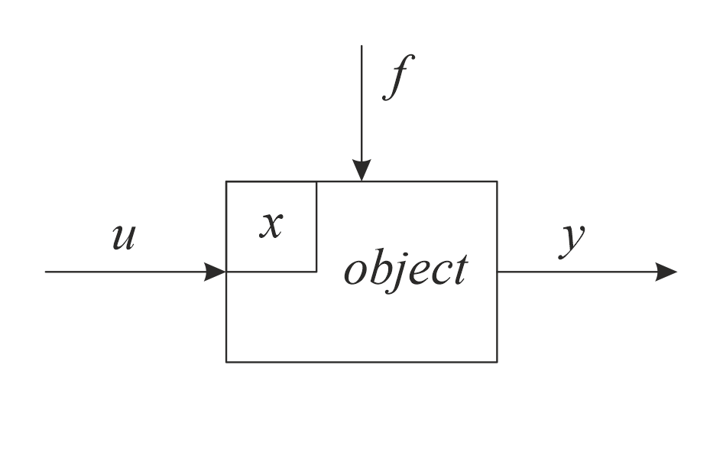
Basic concepts
y is the output value (sensor readings);
f is the influence of the environment on the behavior of the object, the disturbance;
u is the control value (implemented, for example, by engines);
x - state vector, a set of parameters characterizing the internal state of the object
The dimension of the vector x is the order of the object

Slide 6
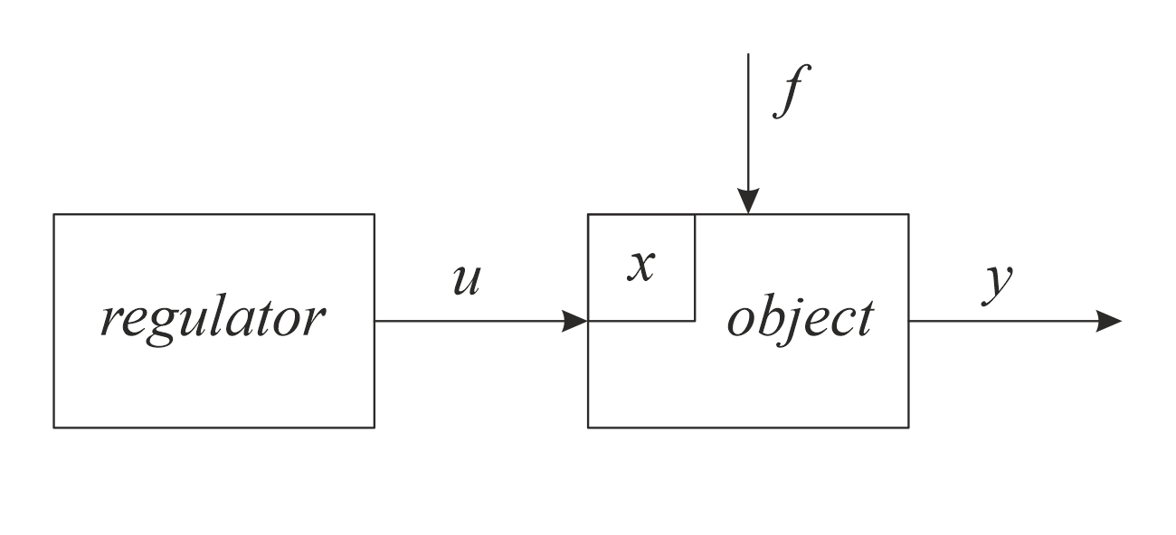
Basic concepts
The task of control system is to develop such a control action u to provide a given change controlled variable y, despite the interfering disturbance f and the object's own properties .
Types of control:
open loop control

Slide 7
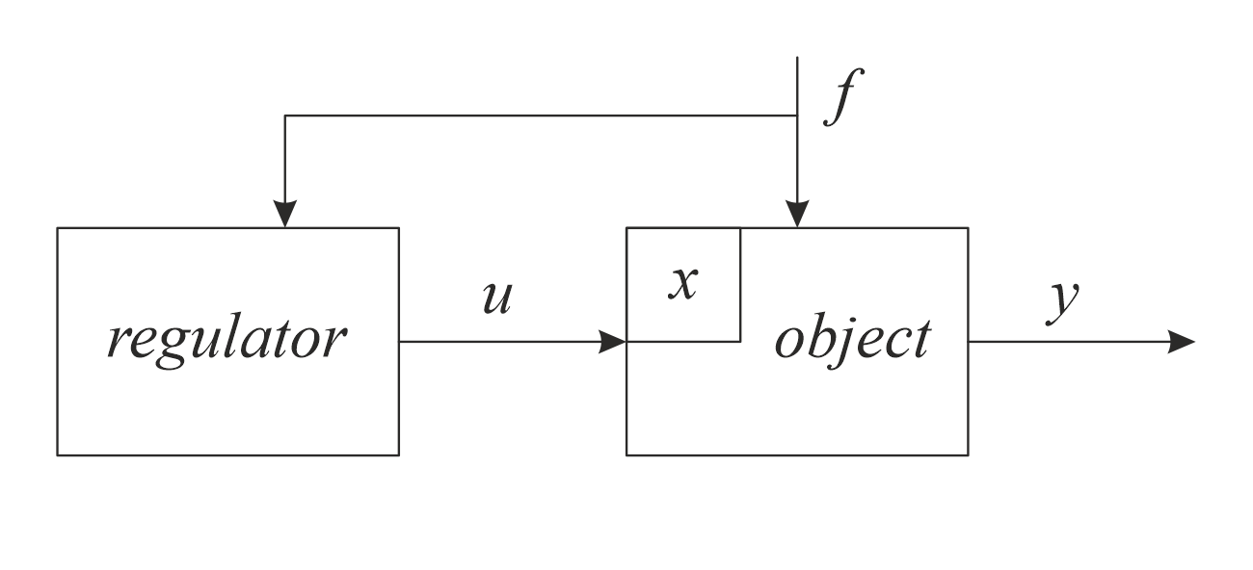
Basic concepts
The task of control system is to develop such a control action u to provide a given change controlled variable y, despite the interfering disturbance f and the object's own properties .
Types of control:
disturbance control

Slide 8
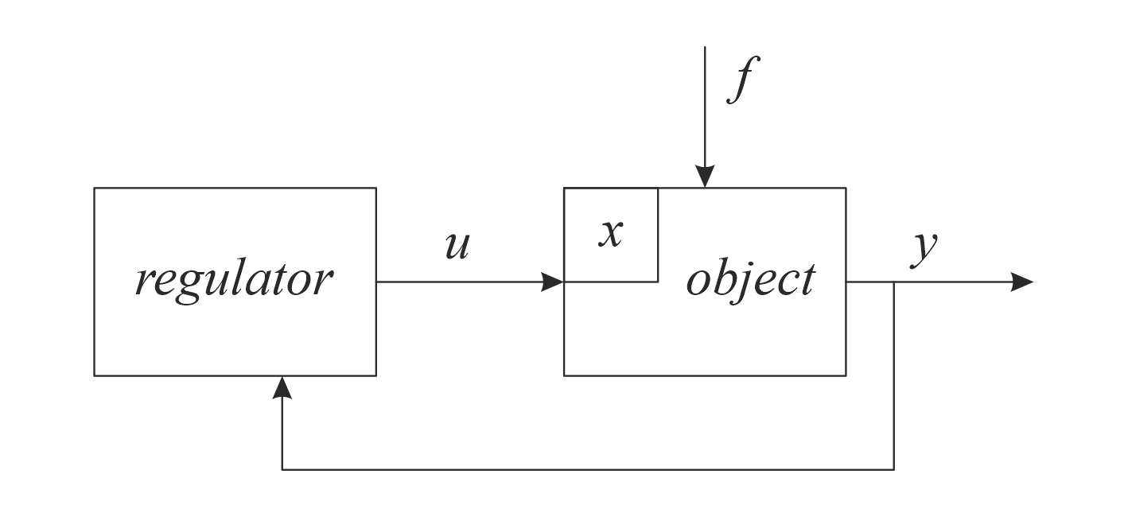
Basic concepts
The task of control system is to develop such a control action u to provide a given change controlled variable y, despite the interfering disturbance f and the object's own properties .
Types of control:
feedback control

Slide 9
Control principles
The following dependencies are programmed in the controller:
For each value f the equation is solved in the controller
Where is the required value of the increment of the control action, compensating for the influence of the disturbing action:

Slide 10
Regulatory principles
In a feedback system, the readings of the sensor that measures the output value y are entered into the controller.
From the upper control level, the master action g is introduced into the controller .
The controller calculates the deviation of the output value y from the reference value g :
Deviation ε is called control error.
In the controller, such a control action u is calculated in order to reduce the error value to zero. It doesn't matter why the error occurred. This is the universalism of the feedback principle.

Slide 11
Classification of control systems
Distinguish following types according to the type of the reference signal g :
stabilization system
automatic programming system
g(t) is a given function of time
tracking system
g(t) is a random, unknown beforehand function

Slide 12
Classification of control systems
By type of mathematical models:
linear system (behavior is described by a linear model)
nonlinear system
Let, an output signal y₁ (t) corresponds to an external signal u₁(t), when it is applied to the input of the system, and an output signal y₂ (t) corresponds to an external signal u₂(t), when it is applied to the input of the system.
Now let's submit:
If:
then the system is linear.

Slide 13
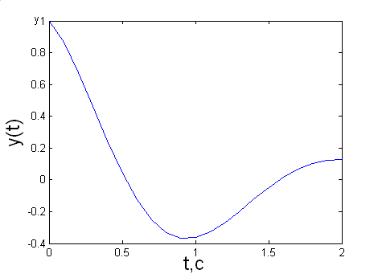
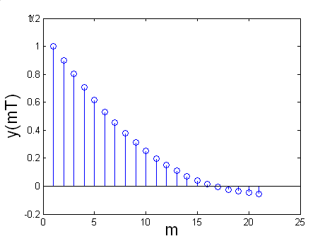
Classification of control systems
By signal type:
Continuous or analog. At any point in the system, the signals are continuous functions:
Discrete. At least in one place of the system, the signals are lattice functions:

Slide 14
Criteria for the quality of control systems
Faculty of Control Systems and Industrial Robotics , ITMO University , Saint Petersburg

Slide 15
Quality of control systems
The control system must be stable and also must have a certain quality of the transition process .
Errors in steady state conditions should not exceed admissible values.
Numerical characteristics are needed to evaluate the effectiveness of control systems.
Quality criteria make it possible to quantify various automatic control systems.

Slide 16
Classification of quality indicators
Direct indicators. Determined directly from the transient response of the process.
Root indicators. They are determined by the roots of the characteristic polynomial.
Frequency indicators. Determined by frequency characteristics.
Integral indicators. Obtained by integrating functions.

Slide 17
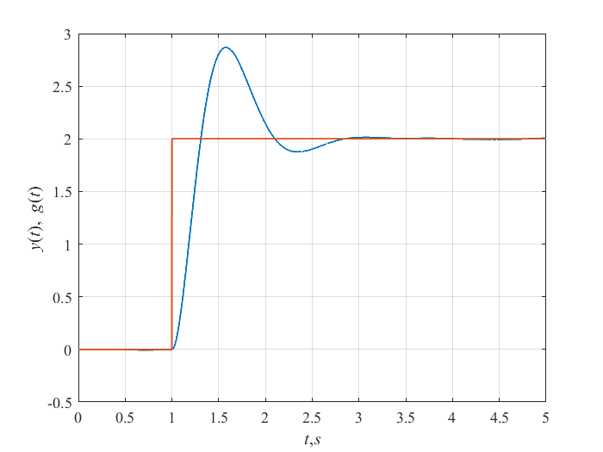
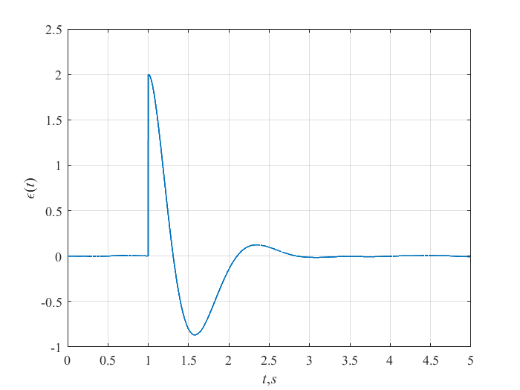
Direct indicators of quality
Regulation error.
absolute error:
relative error:
maximum absolute error:
maximum relative error:

Slide 18
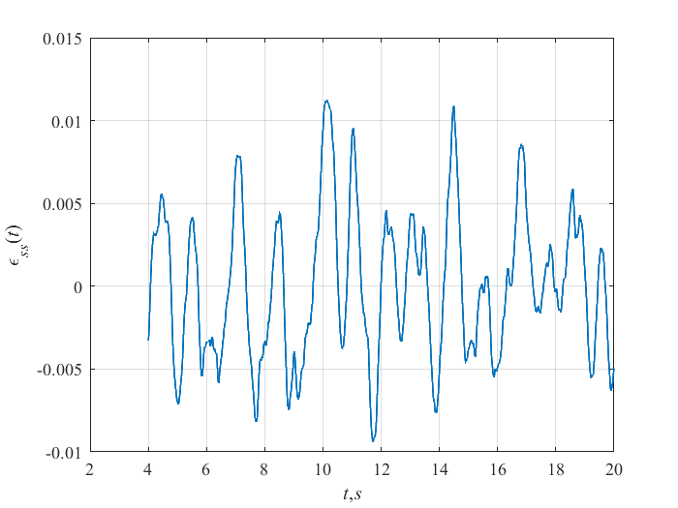
Direct indicators of quality
Regulation error. Typical mode – constant reference signal.

Slide 19
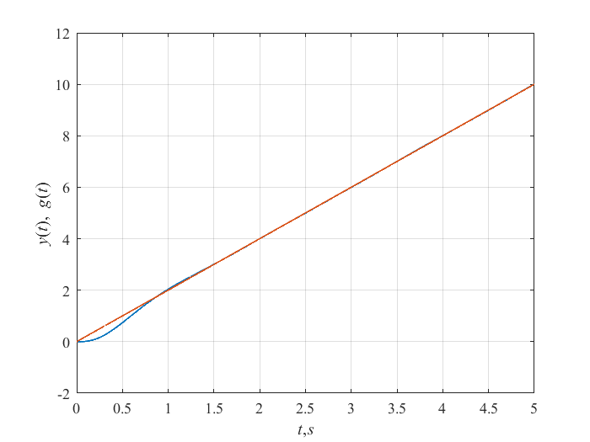
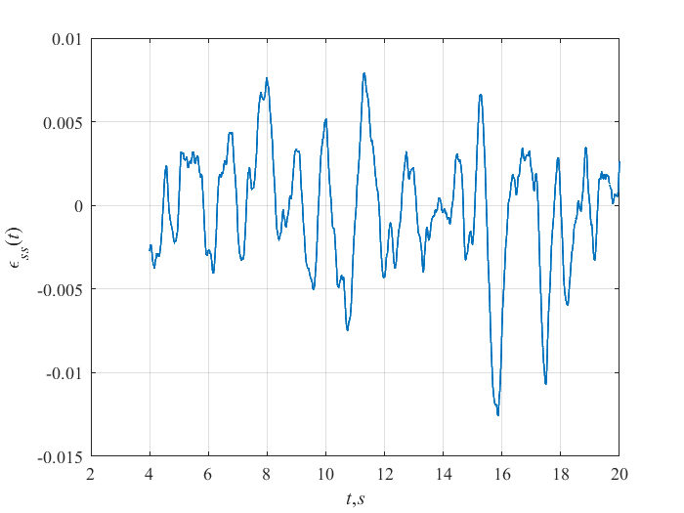
Direct indicators of quality
Regulation error. Typical mode - movement at a constant speed.

Slide 20
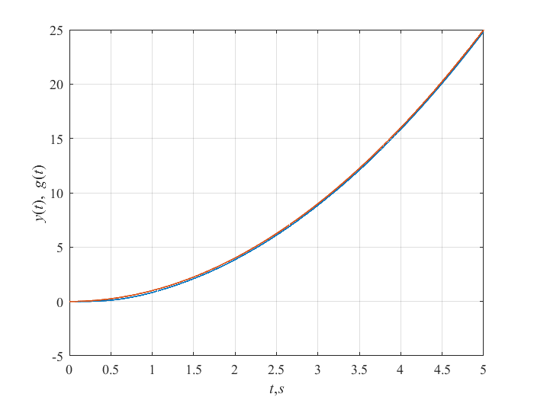
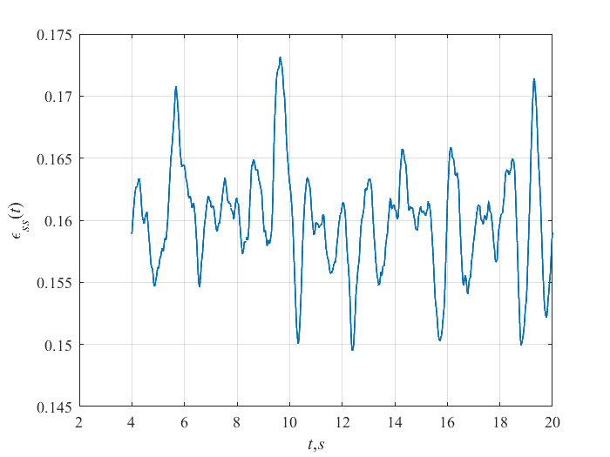
Direct indicators of quality
Regulation error. Typical mode - movement with acceleration.

Slide 21
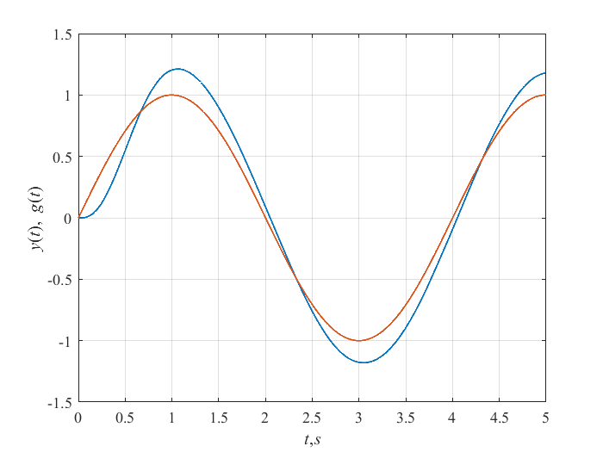
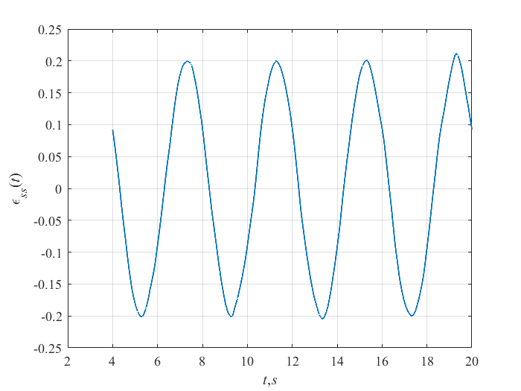
Direct indicators of quality
Regulation error. Typical mode - movement along a sinusoid.

Slide 22
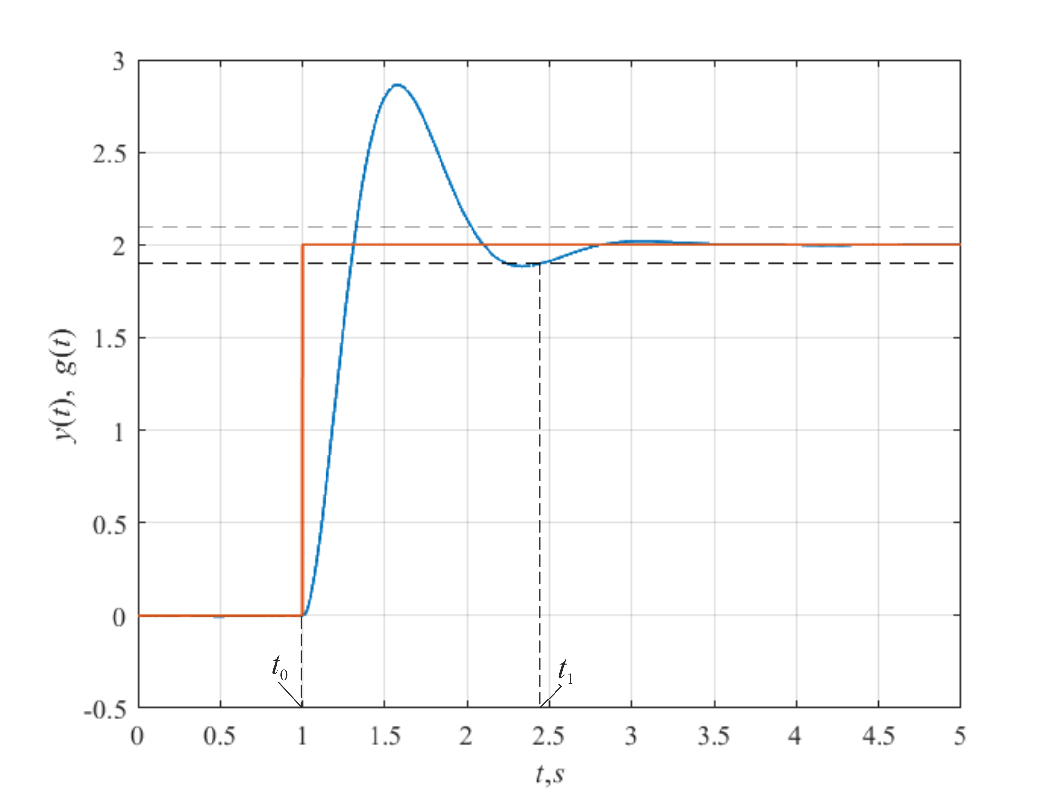
Direct indicators of quality
Transient time
where:
t ₀ is the time of the beginning of the transient process;
for which is true:
Usually:

Slide 23
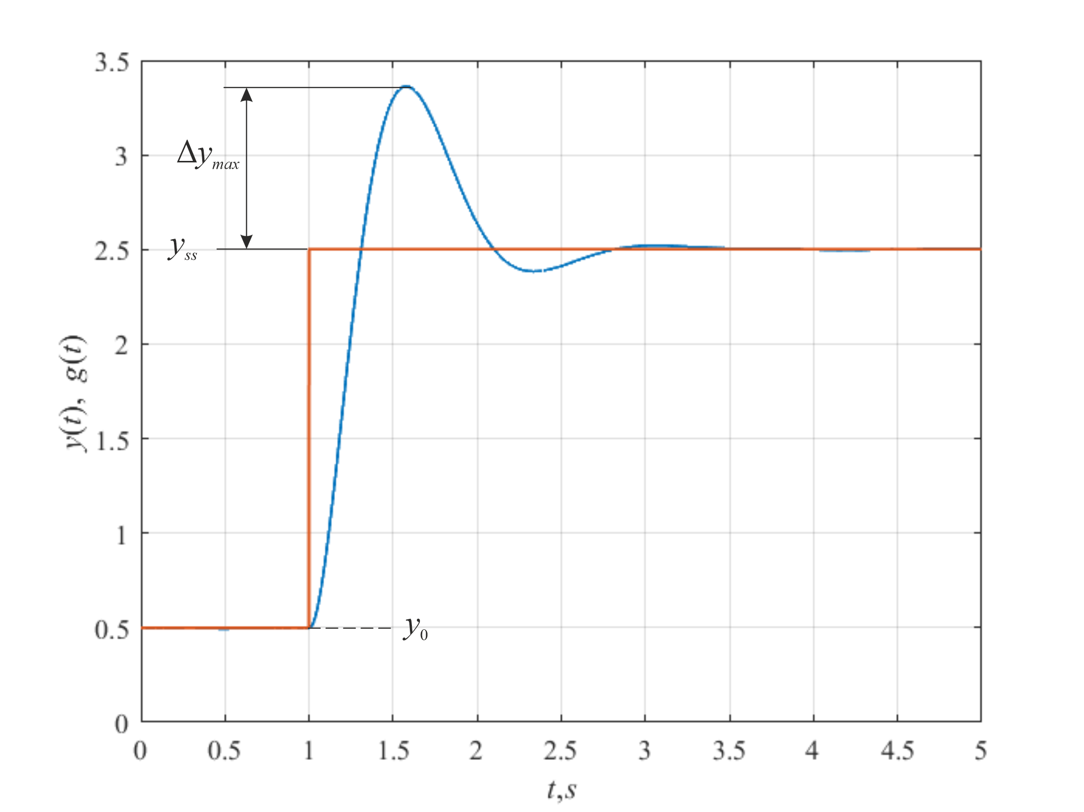
Direct indicators of quality
overshoot
where:

Slide 24
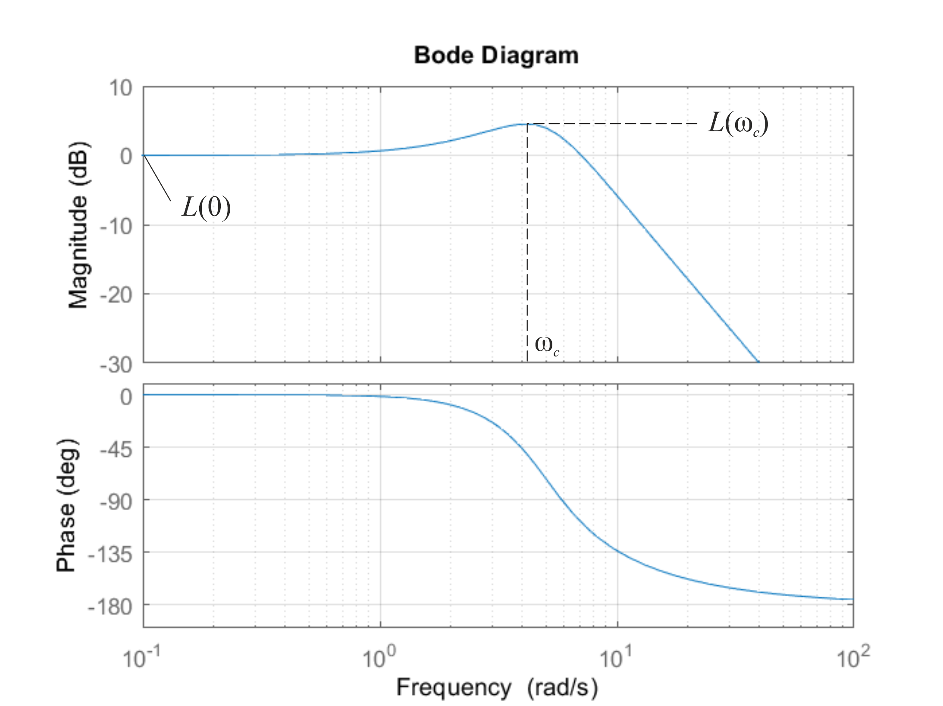
Direct indicators of quality
Oscillation
For a satisfactory transition process :
In well damped systems :
Some systems allow :

Slide 25
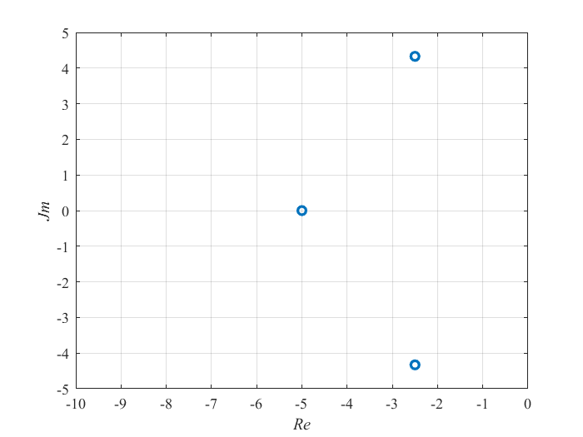
Root characteristics
Let the transfer function of the analog system be :
The denominator of the transfer function determines the stability of the system.
Poles of a stable system.
- zeros of the system;
- poles of the system.
For stable systems:

Slide 26
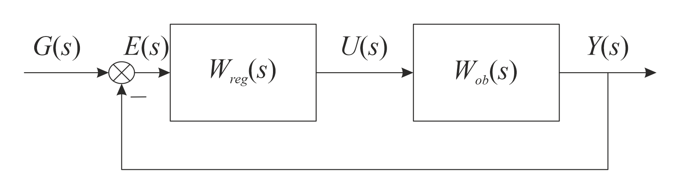
Frequency characteristics
Consider the following transfer function :
This is the transfer function of an open-loop control system.
The frequency response of this transfer function makes it possible to evaluate the stability of the control system.

Slide 27
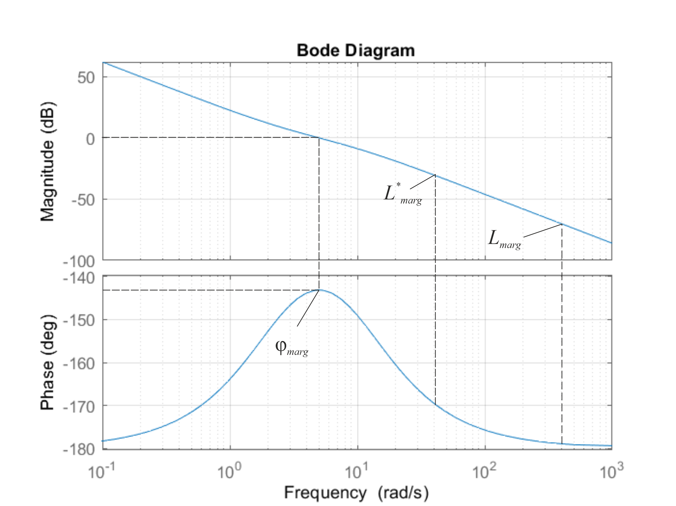
Frequency characteristics
Amplitude and phase frequency characteristics of the transfer function of an open-loop control system
( φ _{marg} + 180) - phase margin of the control system;
(0 – L _{marg} ) – amplitude margin of the control system.

Slide 28
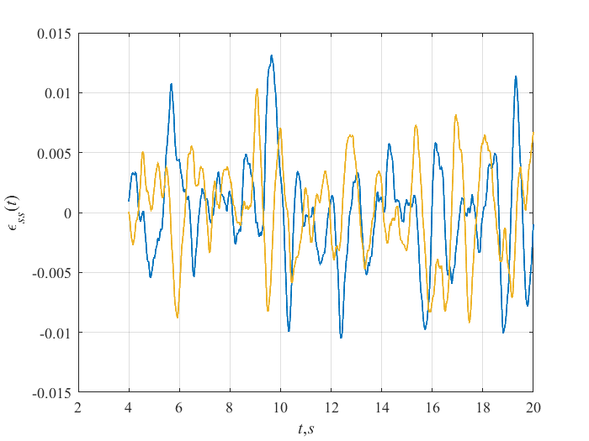
Integral characteristics of quality
Root-mean-square error :
It characterizes the spread of the error relative to the mean value.
For the blue graph:
For the yellow graph:

Slide 29
Accuracy indicators of control systems
Faculty of Control Systems and Industrial Robotics , ITMO University , Saint Petersburg

Slide 30
Steady-state error study
Limit value theorem :
This formulas are valid only if the stability condition is satisfied for F(s) , and the number of roots located on the imaginary number axis should not be more than one.

Slide 31
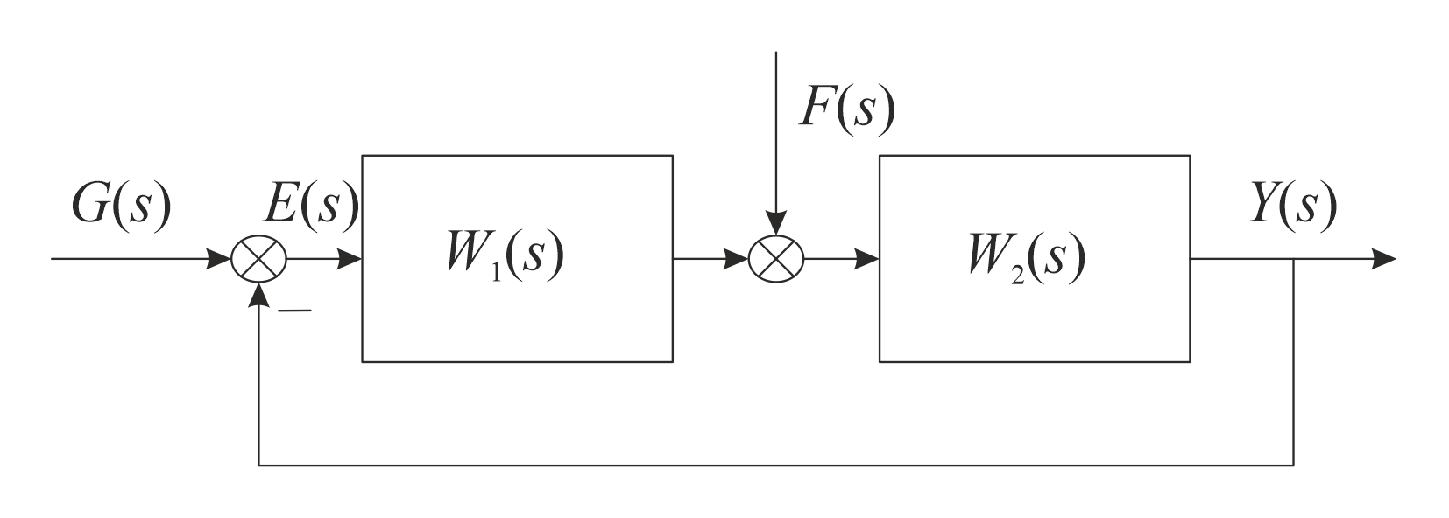
Steady-state error study
Then:

Slide 32
Steady-state error study

Slide 33
Steady-state error study

Slide 34
Steady-state error study
Coefficients c_{g0}, c_{g1}, c_{g2}, c_{g3}, ... are called reference error coefficients.

Slide 35
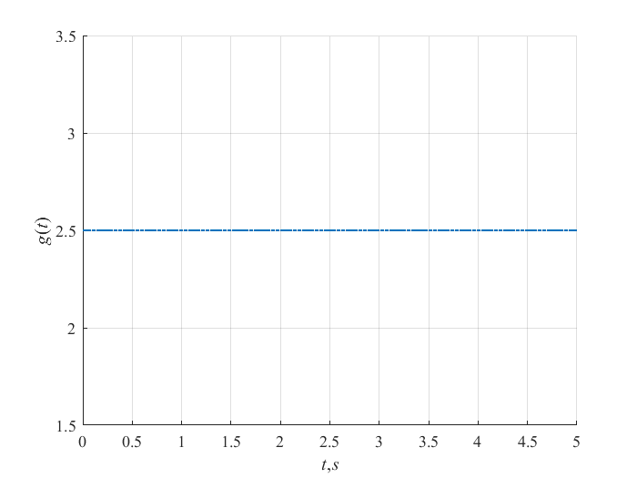
Steady-state error study
Let be:
Let's use:
Substitute:
in:
and get:

Slide 36
Task 7
What is the steady-state error of the control system when applying the task shown in the figure. Transfer function of an open-loop system:

Slide 37
Task 8
What is the steady-state error of the control system when applying the task shown in the figure. Transfer function of an open-loop system:

Slide 38
Steady-state error study
Consider:
Then:
If the transfer functions W ₁ ( s ) and W ₂ ( s ) do not contain integrating links, then:

Slide 39
Steady-state error study
Consider:
Then:
If the transfer functions W ₁ ( s ) and W ₂ ( s ) contain integrating links, then:

Slide 40
Typical Regulators
Faculty of Control Systems and Industrial Robotics , ITMO University , Saint Petersburg

Slide 41
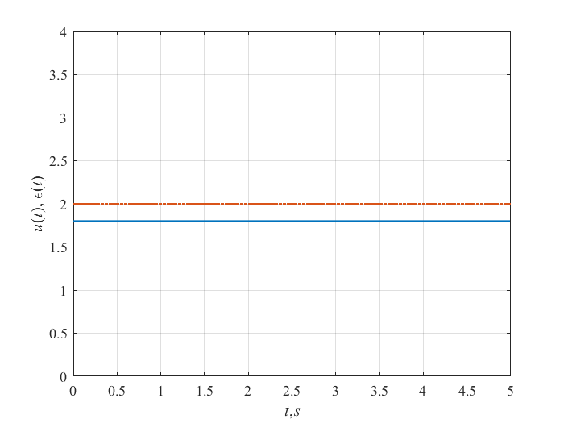
P-regulator
Formula for calculating the analog regulator:
Transfer function of the controller:
Reaction to a permanent error.

Slide 42
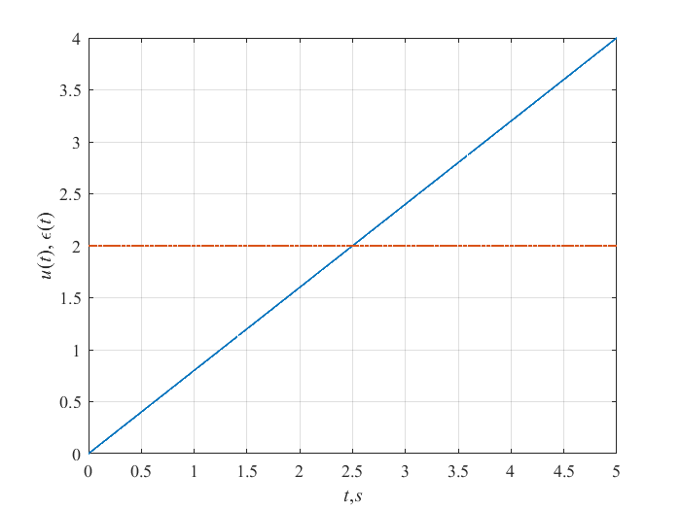
I controller
Formula for calculating the analog regulator:
Transfer function of the controller:
Responce to a constant error.

Slide 43
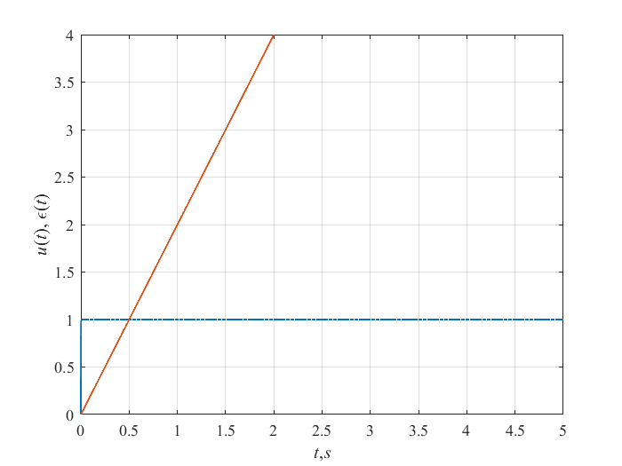
D-regulator
Formula for calculating the analog regulator:
Transfer function of the controller:
Transfer function of a real D-controller:
Response to a linearly increasing error.

Slide 44
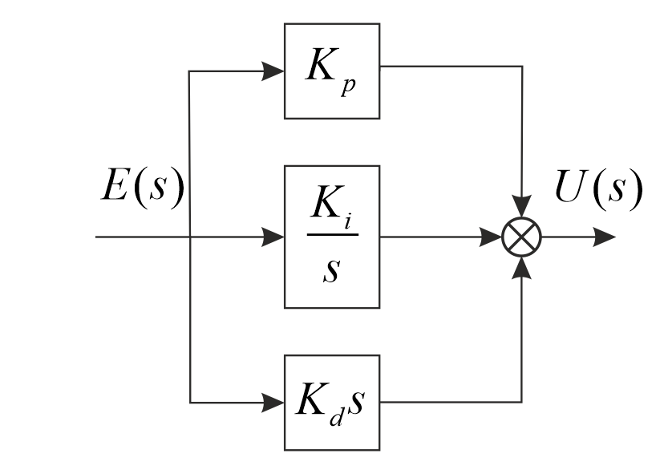
PID controller and its special cases
Formula for calculating the analog PID controller:
PID controller transfer function :

Slide 45
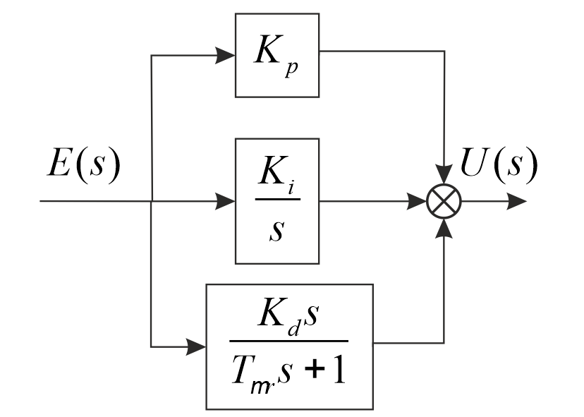
PID controller and its special cases
Transfer function of a real PID controller:

Slide 46
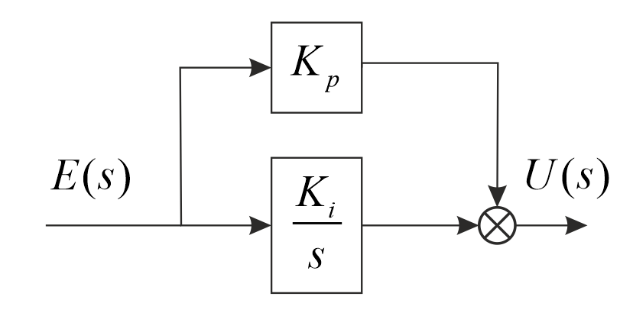
PID controller and its special cases
Formula for calculating the analog PI controller:
Transfer function of the PI controller:

Slide 47
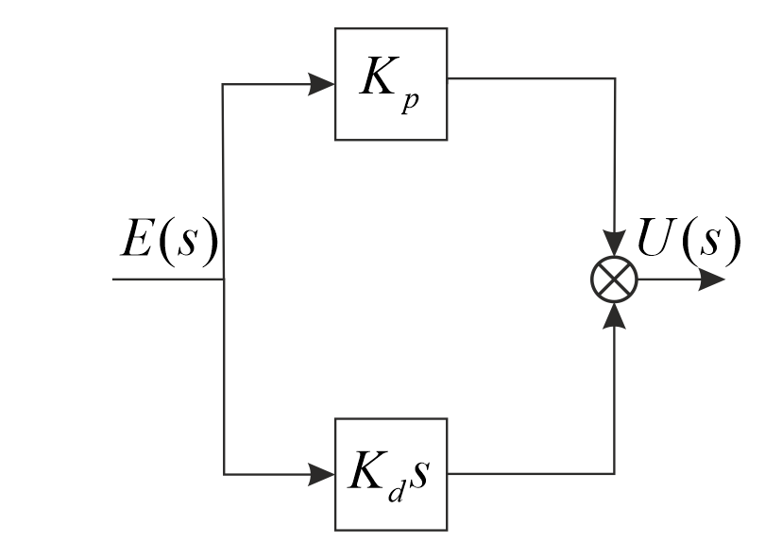
PID controller and its special cases
Formula for calculating an analog PD controller:
Transfer function of the PD controller:

Slide 48
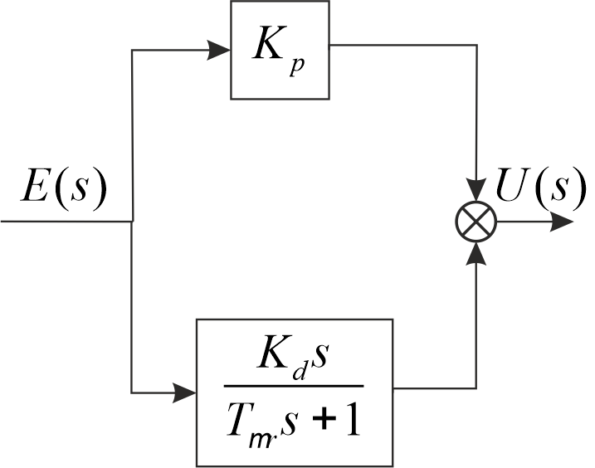
PID controller and its special cases
Transfer function of a real PD controller:

Slide 49
Ziegler-Nichols method
Faculty of Control Systems and Industrial Robotics , ITMO University , Saint Petersburg

Slide 50
Typical Regulators
In most cases, a properly tuned PID controller satisfies all system requirements.
According to statistics: more than 90% of industrial controllers are PID controllers.

Slide 51
Ziegler-Nichols method
proposed in 1943
based on the use of data obtained experimentally on a real object.
refers to empirical methods
The most famous are two options for setting the controller parameters using the Ziegler - Nichols method .

Slide 52
Ziegler-Nichols method
The first option is based on the use of stability margins. In this version, the tuning procedure begins with an experimental study of a system consisting of a P-controller and a given control object. Algorithm :
1. Increase the transfer coefficient of the P-regulator until oscillations with a constant amplitude of oscillations are established at the output of the system, that is, the system is on the border of stability.
2. Fix the value of the transfer coefficient of the controller k_{p}* .
3. Measure the period T* of oscillations established in the system.
4. Calculate the values of the parameters of the controller of the selected type

Slide 53
Ziegler-Nichols method
 | K_{p} | K_{i} | K_{d}
P-regulator | 0.5∙k_{p}*
PI controller | 0.45∙k_{p}* | 0.54∙k_{p}* / T *
PID controller | 0.6∙k_{p}* | 1.2∙k_{p}* / T * | 0.075k_{p}* ∙ T *

Slide 54
Ziegler-Nichols method
Disadvantage:
It is necessary to bring the system to the stability boundary, which is not recommended for many control objects.

Slide 55
Ziegler-Nichols method
Second option. Based on transient response analysis:

Slide 56
Ziegler-Nichols method
The equivalent transfer function of the object has the form:

Slide 57
Ziegler-Nichols
The values of the controller parameters are calculated directly from the values of the parameters k, T and 𝜏.
 | K_{p} | K_{i} | K_{d}
P-regulator | T/k∙𝜏
PI controller | 0.9T/k∙𝜏 | 0.3T/k∙𝜏²
PID controller | 1.2T/k∙𝜏 | 0.6T/k∙𝜏² | 0.6T/k
The method gives satisfactory results if 0.15 < 𝜏 / T < 0.6 .

